Slide 2
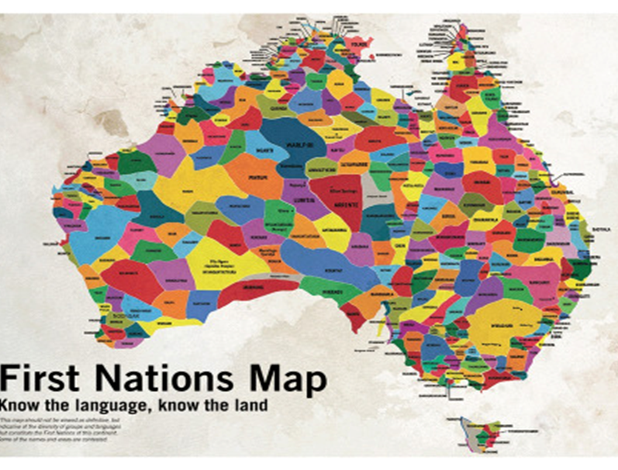
Acknowledgement of Country
OFFICIAL

Slide 3
New CCAFL framework – renewal process
CCAFL is a national arrangement where:
all agencies across Australia share a curriculum and assessment model for 27 small enrolment languages.
The new framework:
was consulted on across Australia in 2021
drew on national subject expertise – grammar, resources, topics
is embedded in each state’s curriculum – we share content and exam
will be implemented in 2024 (Stage 1) and 2025 (Stage 2).

Slide 4
The Curriculum Innovation Project - Languages
is the reason for minimal changes
hopefully, relevant learnings from this can be applied to SACE nationally assessed languages at continuers level

Slide 5
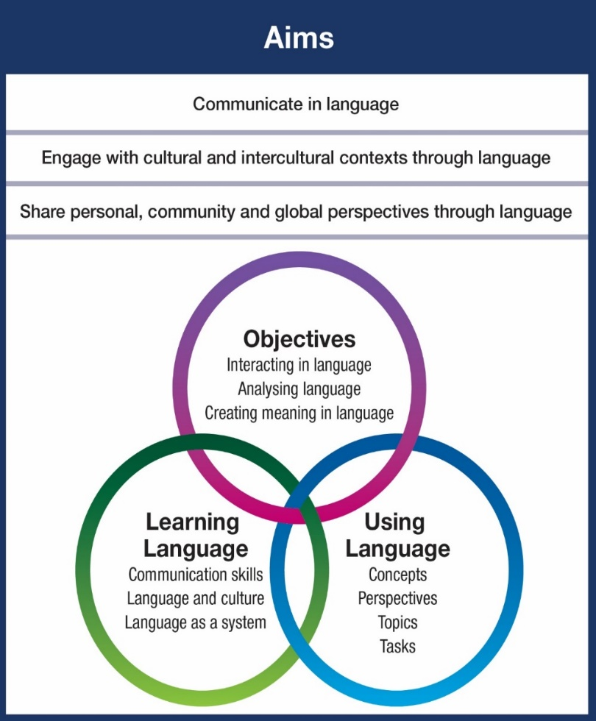
New CCAFL framework
The new framework:
provides high quality, inclusive curriculum
values prior learning
emphasises effective communication and intercultural competence
introduces new concepts, topics and perspectives
- and allows these to be explored within the Australian context.

Slide 6
What’s new in the subject outline?
Section | Nature of change
Subject description | No change
Capabilities | Minor changes
Learning requirements | Minor changes to language (not intent)
Content | NEW
Assessment design criteria | No change
School assessment (Stage 1 and Stage 2) | Minor change (new concepts, topics, perspectives)
Stage 2 external assessment (written exam) | NEW
Stage 2 external assessment (oral exam) | Minor change (student's investigation topic to align with new concepts and perspectives)
Performance standards | No change
Grammar, dictionaries, subtopics | NEW EXAMPLES

Slide 7
Stage 1 and Stage 2 learning requirements
Current | New
Students are expected to develop and apply linguistic and intercultural knowledge, understanding and skills when:
interact with others to exchange information, ideas, opinions, and experiences in [Language] | interacting in [Language]
create texts in [Language] to express information, feelings, ideas, and opinions | creating meaning in [Language]
analyse texts that are in [Language] to interpret meaning | analysing [Language]
examine relationships between language, culture, and identity, and reflect on the ways in which culture influences communication. | examinng relationships between language, culture, and identity, and reflect on the ways in which culture influences communication.

Slide 8
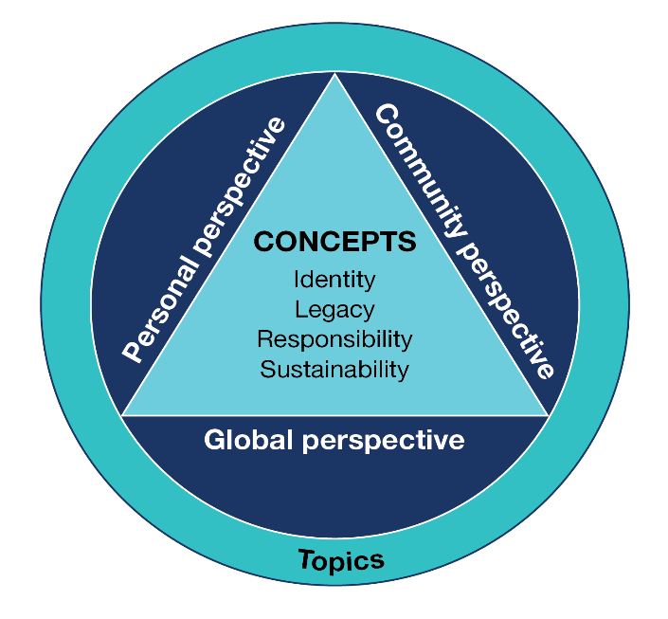
Content
Concepts
Identity
Legacy
Responsibility
Sustainability
Australian focus

Slide 9
Topics
All languages have 8 prescribed topics which relate to the four concepts
Only 4 are common to all languages. These are innovation, society, sustaining language and culture and inclusivity, diversity and belonging
The remaining 4 relate to the concepts but are specific to each language
Concept Common to all languages | 4 prescribed topics (common to all languages) | + 4 additional topics (varies between languages)
Legacy | Innovation | History and traditions or [Language] speaking culture
Responsibility | Society | Work or Youth
Sustainability | Sustaining language and culture | Natural environment or Global trends
Identity | Inclusivity, diversity and belonging | Living in Australia or Relationships and human Interactions
Take care to address the topics for your language

Slide 10
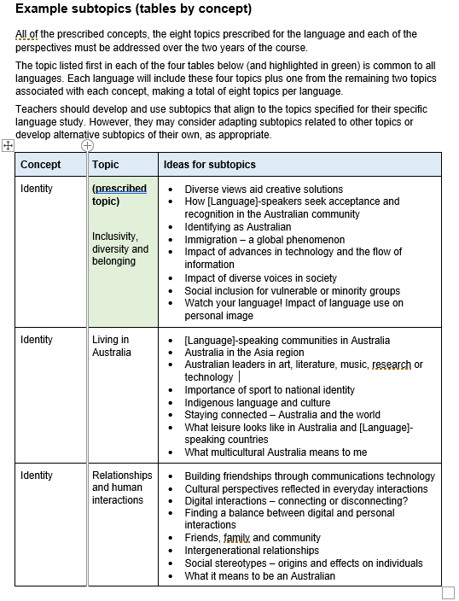
Subtopics
there are NO prescribed subtopics.
ideas for subtopics are just examples,
tailor this to the needs/interests of your students.
provide the opportunity to engage with:
- all 8 topics
personal, global, and community perspectives
some content with an Australian focus

Slide 11
An Australian focus
Provide opportunities for students to study one or more subtopics with a focus on Australian content
This may be related to aspects of the Australian way of life, or to the environment, or sport, art, or other areas of interest.

Slide 12
What this could look like
EXAMPLE of new model | EXAMPLES
Concept Common to all languages | Prescribed topics | Examples of subtopics | Perspective
Identity | Inclusivity, diversity and belonging | How successful have moves towards greater inclusivity over the last decade been in Australia and [country]. | Community
Legacy | Innovation | Innovations I can’t live without | Personal
Responsibility | Society | Volunteering and how to make positive changes in the community | Community
Sustainability | Sustaining language and culture | The place of slang and English influences in modern [Language] mass media. | Global

Slide 13
Perspectives
What are the perspectives in the new framework?
Personal perspective
Community perspective
Global perspective
The perspectives are similar in scope to the current themes
Personal perspective | Community perspective | Global perspective
The individual | The language speaking communities | The changing world
Perspectives are prescribed content
Each perspective must be addressed across Stage 1 and 2
Any topic can be studied from any perspective

Slide 14
Perspectives
Concept Topic Subtopic and Perspective
Concept – Legacy
Prescribed topic – Innovation
Subtopic (for the concept of Legacy) | Perspective
Innovations I can’t live without OR | Personal
Meeting the challenges of living in the 21st Century through innovation and invention OR | Community
Innovations that changed the world | Global

Slide 15
Perspectives
Concept Topic Subtopic and Perspective
Concept – Identity
Prescribed topic – Inclusivity, diversity and belonging,
Subtopic (for concept of Identity) | Perspective
Watch your language! The impact of language on personal image and identity OR | Personal
How successful have moves towards greater inclusivity over the last decade been in Australia and [country]? OR | Community
Immigration – a global phenomenon | Global

Slide 16
Activity
Focusing on perspectives
Concept – Responsibility
Prescribed Topic – Society
Subtopic | Perspective
 | Personal
Volunteering and how to make positive changes in the community | Community
 | Global
Subtopic | Perspective
Responsibilities I have in my community | Personal
Volunteering and how to make positive changes in the community Attitudes to an aging population (comparison) | Community
Staying connected locally and globally Good global citizenship | Global

Slide 17
Activity 2
Having completed this, do you notice any concepts which you already feel comfortable teaching? Which ones are these?
Which concepts will provide you with a challenge to extend your resources and teaching repertoire? How can you start to do this?
Reflect on the perspectives. Is this something you already include in your lessons?
In your current teaching repertoire, do you see a clear strength in the inclusion of one perspective over others?
How can you include all perspectives into your programmes?
Will including subtopics with an Australian focus change the way you approach your planning? If yes, how will this look?

Slide 18
Changes for Stage 1 assessment types in 2024
Stage 1 | Specifications
Assessment Type 1: Interacting in Language (replaces Interaction) | Assessments specify context, purpose, audience, and the concept and perspective
Assessment Type 2: Creating Meaning in Language (replaces Text Production) | Assessments specify text type for production, kind of writing, and the concept and perspective
Assessment Type 3: Analysing Language (replaces Text Analysis) | Assessments should enable students to interpret meaning in text(s) by identifying and explaining content, context, purpose, audience and the concept and perspective represented in texts.
Assessment Type 4: Investigation | Associated with one of the four new concepts (not current themes)
Slight change to titles Concepts, topics, and perspectives (replace the current themes and topics) Assessment design criteria remains the SAME

Slide 19
Stage 2 assessment types (for teaching in 2025)
Stage 2
Assessment Type 1: Folio | The assessments should specify the concept and perspective.
Assessment Type 2: In-depth Study | The assessments should specify the concept and perspective
Assessment Type 3: Oral exam | The assessment should specify the concept and perspective.
Assessment Type 3: Examination | CHANGES TO STRUCTURE
NO change to assessment type titles Concepts, topics, and perspectives are new (replacing the current themes and topics) Assessment design criteria and specifications remain the SAME

Slide 20
Stage 2 external assessment for 2025
Assessment Type 3:
 | New
ORAL EXAM | Section 1: Conversation -- No change Section 2: Discussion Topic of in-depth study must fit into one of the four CCAFL concepts; Identity, Legacy, Responsibility, Sustainability.
WRITTEN EXAM | Key changes include: From 2.5 hours to a 2-hour exam From 3 sections to 2 sections Total listening time reduced by 3 minutes Reading texts from 3 to 2 and 100 words shorter
Section 1: Responding to texts Question 1 - Text 1: One listening text responding in English Question 2 - Text 2: One listening text and responding in language Question 3 - Reading and listening in language and responding in English Section 2: Creating texts Question 4 - Reading and responding in language response approx. 150 words Question 5 or Question 6 Writing in language Response approx. 250 words

Slide 21
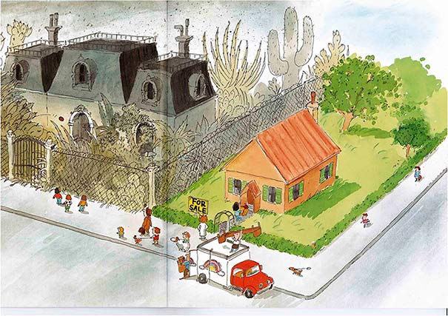
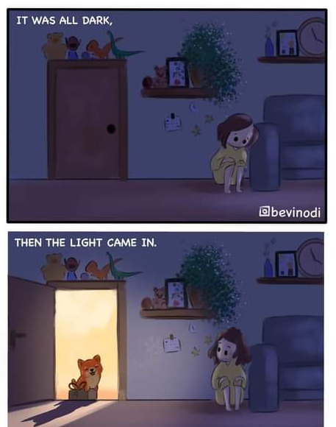
Visual texts
1 or 2 visual texts in any of q 3,4,5, or 6

Slide 22
Sample exam (2025)

Slide 23
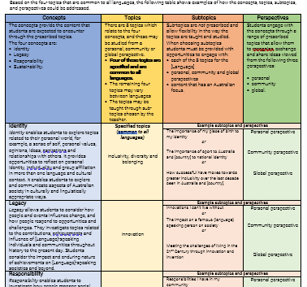
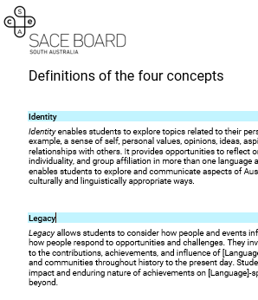
Support materials

Slide 24
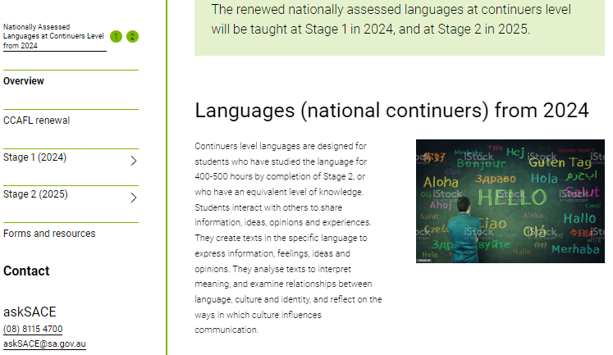
New minisite
https://www.sace.sa.edu.au/web/nationally-assessed-languages-at-continuers-level-from-2024/overview

Slide 25
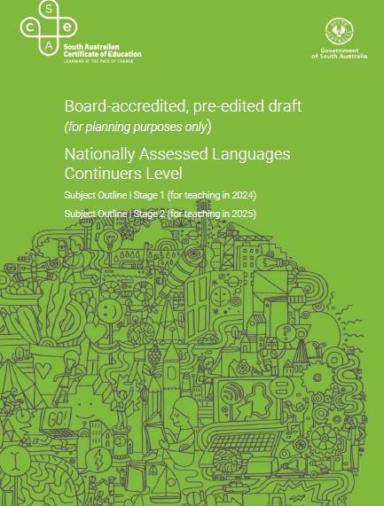
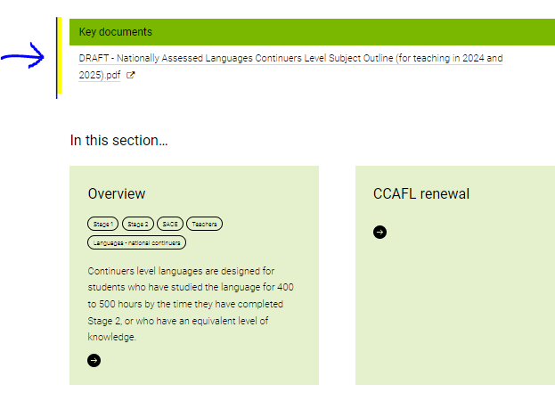
Draft subject outline

Slide 26
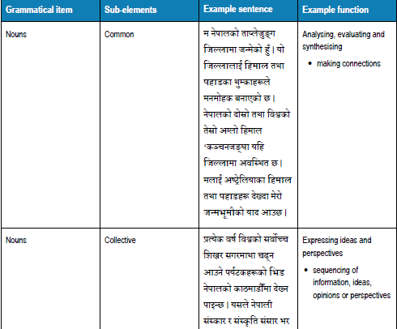
Grammar lists by
language

Slide 27
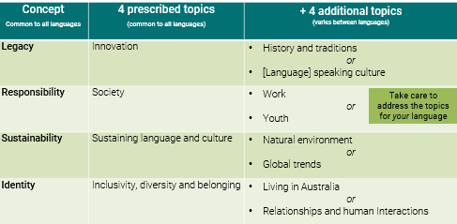
Topics by language
Topics
The following prescribed topics relate to the four concepts:
Identity
Inclusivity, diversity and belonging
Living in Australia
Legacy
Innovation
Nepali-speaking culture
Responsibility
Society
Youth
Sustainability
Sustaining language and culture
Natural environment

Slide 28
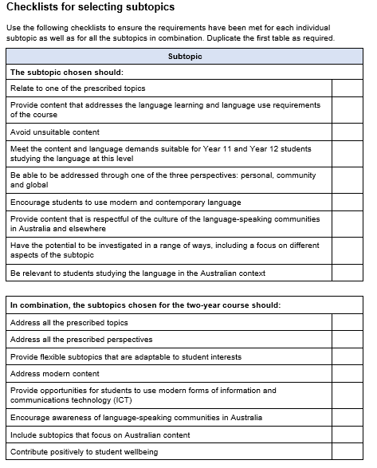
Subtopic checklist

Slide 29
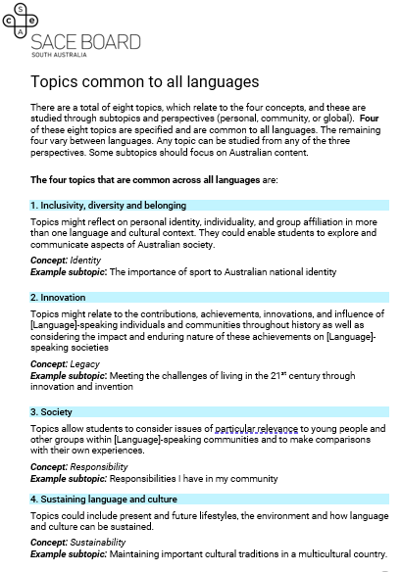
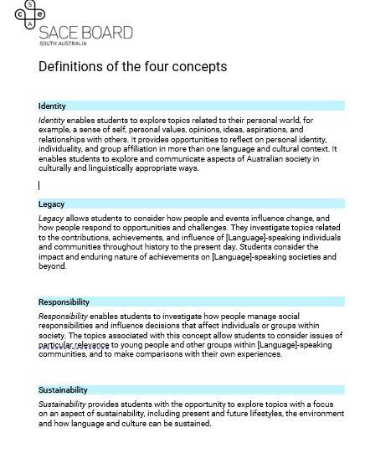
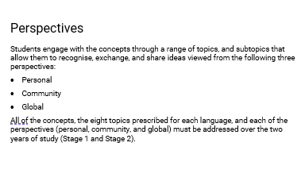
Definitions of concepts, perspectives, and topics

Slide 30
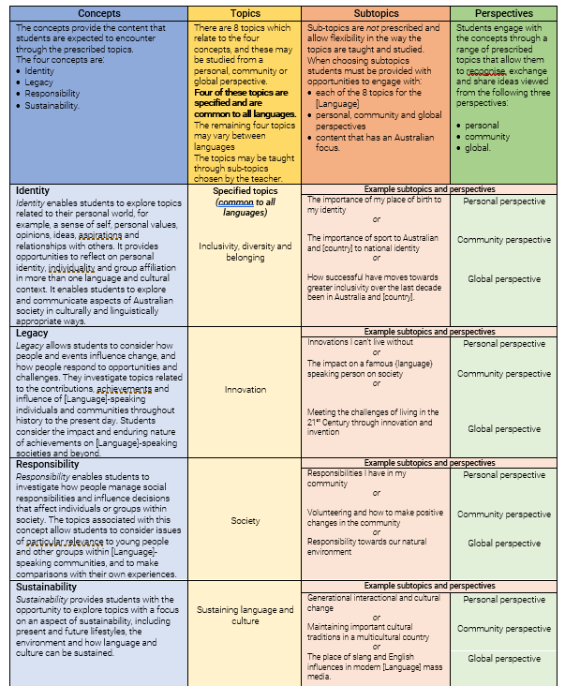
Example concepts, perspectives, topics and subtopics

Slide 31
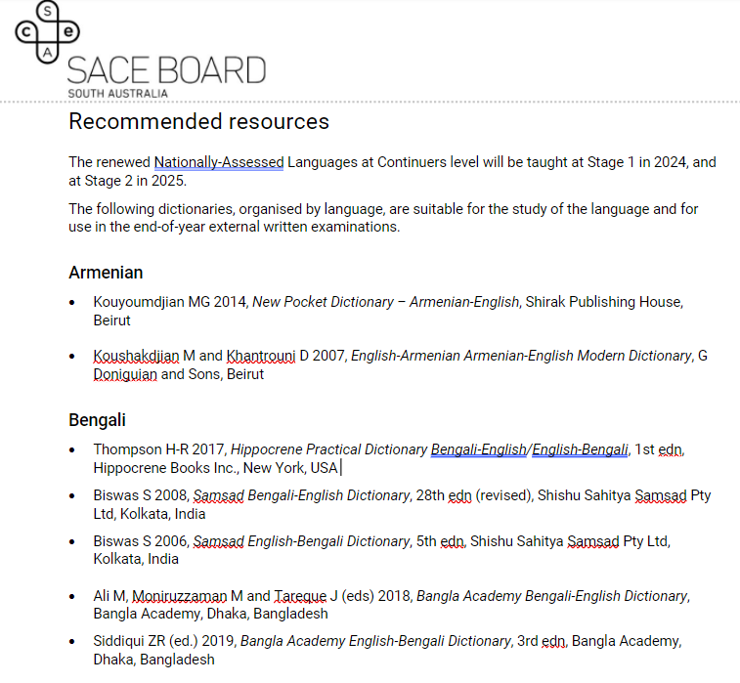
Heading
Recommended resources (dictionaries)

Slide 32
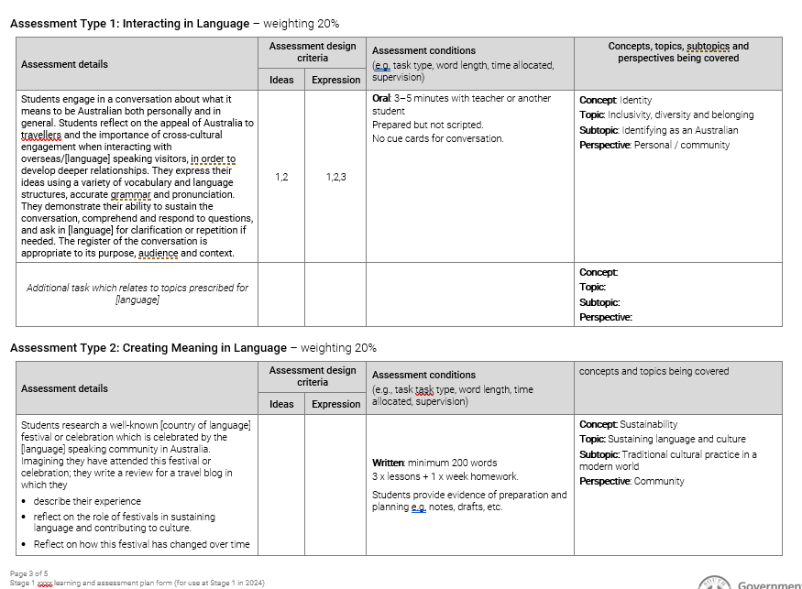
Heading
Sample LAP

Slide 33
Thank you askSACE@sa.gov.au
Karen Collins and Sally Letcher
English & Languages Faculty

