Slide 1
ASSESSMENT TYPE 3: SKILLS DEVELOPMENT PORTFOLIO
SACE ID:

Slide 2
FOUNDATIONS & Development OF (which genre are you focussing on?)
For my Skills Development Portfolio, I decided to focus on the jazz dance genre. Jazz dance movement officially originated during the early 1900’s in New Orleans, and increased its popularity throughout the 1930’s and 1940’s. This newly-found genre became so appreciated over its first years of recognition, that it was eventually known to be as popular as classical ballet, which is known to be much stiffer than the loose movement that jazz dance provides (Study, 2020). The derivation of jazz traces all the way back to African ritual and celebratory dances from around the 17th century, which heavily emphasised polyrhythm and improvisation. There were many varying genres that date back a long while before jazz, which influenced the creation of this dance form, including contemporary, as well as Caribbean and Latin music. The progression of jazz movement since the genre was first branded, up until nowadays, showcases the increasing growth throughout the dance world.

Slide 3
Originally, this dance genre referred to any kind of movement that was performed to jazz music, including tap dancing, being only interpretive and unstructured at first. However, this style quickly evolved to become more structured and theatrical-inspired, in which studios began to inherit within their own dance tuition (Starnes, 2020). Eventually, the jazz dance genre branched off to introduce Broadway, a style that was prominently produced for staged productions. This opened up a new, curious crowd to the interesting fusion of jazz and ballet dance, alongside dramatic acting (Pico, 2015). To this day, jazz remains extremely popular all over the world, where it’s constantly developing as today’s modern dance generation continues to advance. While the genre incorporates a variety of classical movements, its fast paced, high level of improvisation and upbeat music keep this style a favourite amongst many (Starnes, 2020).

Slide 4
What are the defining technical and stylistic features of your chosen dance genre?
There are many defining technical and stylistic features of the jazz dance genre, with the key body parts in motion being the feet, arms, as well as varying hand positions. Jazz music involves differing elements, where its form retains its essential character, no matter what influences are absorbed throughout it. Significant characteristics that are incorporated within jazz are isolations (utilising the head, shoulder and hips), timing and shape. Creating a jazz work will most likely incorporate movements such as body rolls, kicks and leaps, resulting in a striking and entertaining performance (Thing Link, 2014). In regard to the stylistic features within jazz dance, you’ll recognise a heavy influence of blues, syncopation, swing, as well as creative freedom. Improvisation isn’t an uncommon, nor new occurrence when demonstrating jazz movement, as this was known to be a popular form of interpreting the genre back when this form of dance first originated (New York Jazz Workshop, nd). Outfits or costumes that relate to the jazz genre are generally form-fitting, enabling the dancer to move freely and with great ease, while providing extensive comfort. They broadly range in colour and style, where they’re designed to show off the dancers body, without being inappropriate to a specific age group. (Thing Link, 2014).

Slide 5
Analysis of a professional dancer
I believe that Maddie Ziegler’s performance of her jazz solo Bond Girl, consists of many strengths, as well as weaknesses. Maddie demonstrates a variety of body bases, with most of the movement done on her feet, however, some on the floor, using her stomach and knees. In addition, Maddie showcased her knowledge of differing dynamics within the one routine, where she incorporated strong, powerful isolations when the music showed evidence of heavy beats. On the contrary light, graceful choreography was demonstrated through kicks, body rolls and aerials. I was unable to find any weaknesses throughout Bond Girl, as I truly think that Maddie demonstrated the defining features of jazz extremely successfully. The many elements of dance and nuances that define this genre were showcased extensively, making Maddie’s solo a perfect example of jazz movement.

Slide 6
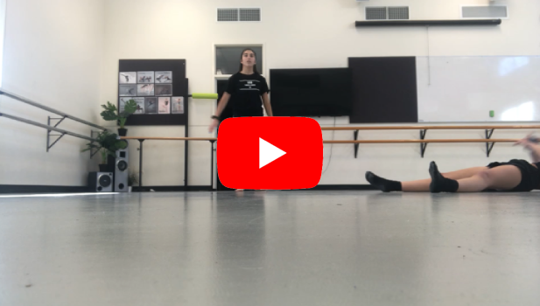
Initial analysis
Term 1 or 2 Performance
Analysis
Within my demonstration of jazz choreography, I was able to use mechanically correct movement patterns, which are specific to the jazz dance genre. This was mainly evident when I showcased a roll to catch myself, immediately after performing a tilt kick which was directed towards the floor. I didn’t warm up prior to doing this choreography, which put me at an extremely high risk of enduring severe injury. However, most of my movement was mechanically safe, where I didn’t perform it at a 100% endurance rate. I believe that I could’ve undergone a much deeper plie in second before doing the tilt kick, which would’ve given me much more power and stability. Having a greater balance on my supporting leg when demonstrating the side tilt could’ve aided me majorly in getting my leg much higher, where an advanced flexibility level is required throughout jazz dance.

Slide 7
Plans for improvement - technique
Ones cardiovascular endurance can be developed in a wide variety of forms, including running, powerwalking, swimming, etc. Anaerobic training can be combined within technique and conditioning programs by including a short, high-intensity activity throughout the beginning of the session. This aspect of the program can involve activities such as sprinting, jumping or heavy weight lifting, which will release quick bursts of energy and are constantly performed at a maximal effort. On the other hand, it’s effective to include an aerobic activity throughout a technique or conditioning program, in order to improve cardiovascular endurance for a longer period of time. Activities such as cycling, jogging or swimming laps can be extremely effective in achieving this.
Developing strength and muscular endurance can also be done by completing a number of activities, including lifting weights, push-ups, as well as working with resistance bands. In order to safely combine these tasks within a technique and conditioning program (as some can be quite dangerous when not done properly), it’s very important to properly warm up before undertaking any kind of muscular and strength activity. In addition, when working with heavy weights or trying out an exercise that’s never been done before, it’s advisable to have some form of supervision from either a personal trainer, a coach, etc.

Slide 8
There are four general methods used when training flexibility: Static, ballistic, PNF and dynamic stretching. Static stretching is when a muscle is stretched to a length that’s uncomfortable, however, not painful. Ballistic stretching involves either a bounce or stretch, and should only be performed after a proper warm up and stretch. PNF stands for proprioceptive neuromuscular facilitation stretching, which is the combination of a 30 second static stretch, followed by of the stretched muscle, before lengthening it out again for another 10 second static stretch. Finally, dynamic stretching is when an athlete performs movements that take their joints through their ROM to produce temporal stretches of selected muscles.

Slide 9
Evidence of technical improvement program
Training Program.docx
Refer to the above link to view my six week training program.

Slide 10
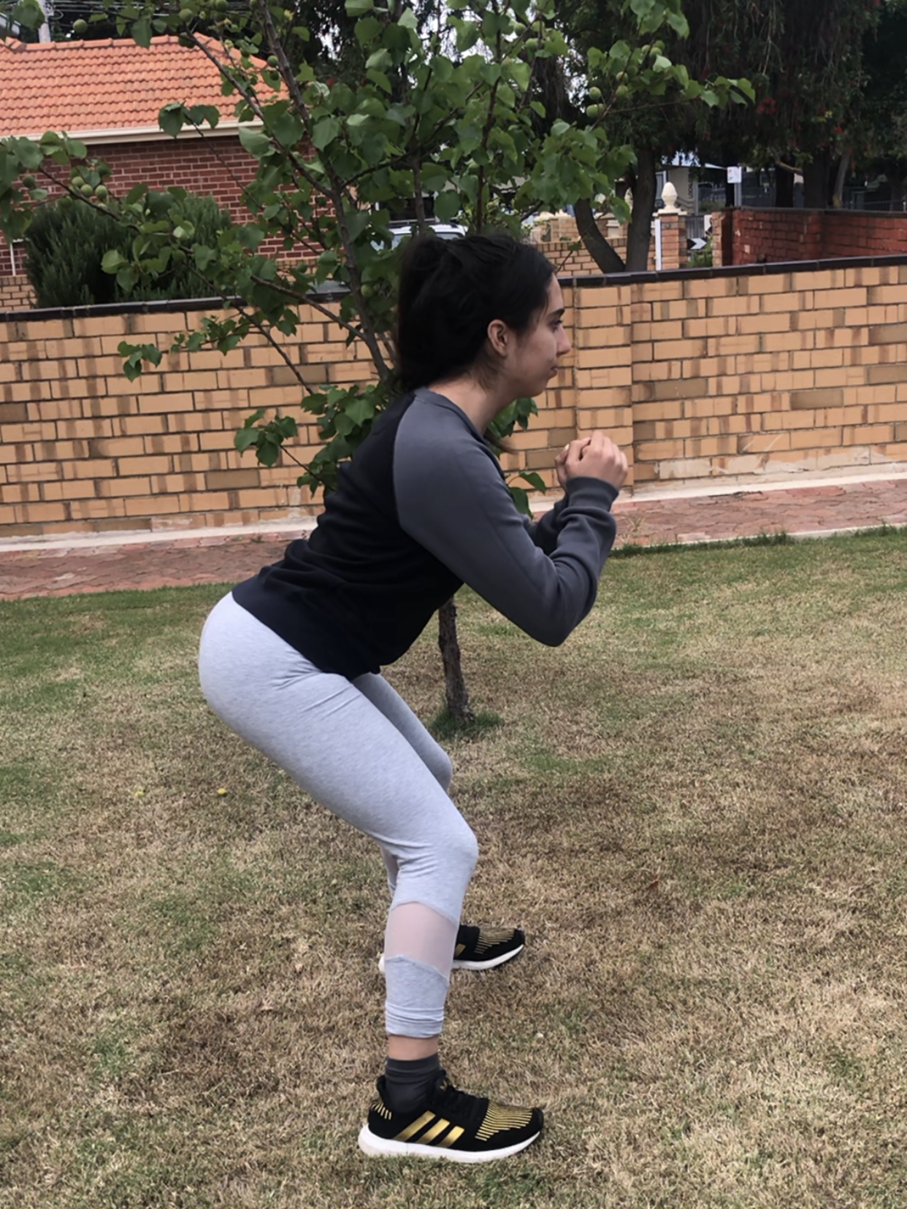
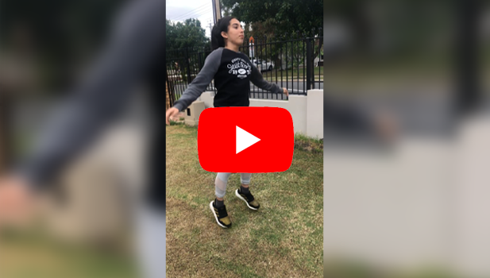
2 photos + a video of me partaking in my scheduled Week 2 workout.

Slide 11
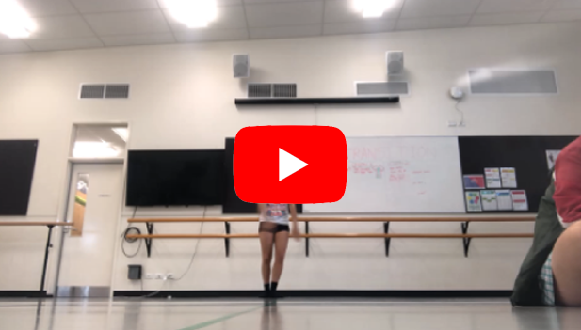
Follow up analysis
Term 3 Performance
Analysis
Since implementing my six-week training program, I believe that I’ve significantly improved in some areas that I was targeting. Although it may not be entirely evident within the video on the left hand side, my ability to action safe dance practices has enhanced. I thoroughly warmed up my body and stretched for around 10 minutes prior to filming this phrase. As a result of this, my muscles were warm, therefore, I was able to perform my movement properly, with greater intensity. Additionally, I was also undertaking further measures that could protect me from gaining injuries. Having an awake and alert body also motivated me to perform the choreography at a much higher endurance rate compared to the previous video. In regard to the tilt kick, I personally believe that I demonstrated its technical processes much clearer this time around, however, the flexibility that defines the movement continued to lack. I ensured to focus hard on achieving a deep plié in second position prior to forcing my leg up, which gave the kick more power an intensity. Furthermore, if I had greater balance in my left supporting leg, I would’ve had more trust in leaning towards the side a bit more, causing greater height in the kick itself. Continuing to rehearse this phrase would aid me in implementing all three components of the tilt kick at once; achieving a deep preparation plié, having a balanced supporting leg, as well as showcasing a more advanced flexibility within the movement.

Slide 12
Evaluation of actions taken & Impact on Development as a dancer
As this assignment is focusing purely on my growth and development as a dancer, I was the only individual involved in my own experience. I was required to identify areas of improvement throughout my execution of a choreographic phrase and devise a training program that will help me improve in these aspects. After deciding on a specific genre that I wanted to focus on, I conducted some research behind the foundations and development of jazz dance. I gained information on the history of jazz, looking at when, where and why it began. Additionally, I discovered the defining technical and stylistic features that encompass this particular genre. Furthermore, I was required to produce an analysis of a professional dancer demonstrating jazz movement. I had carefully observed the Elements of Dance that Maddie Ziegler was showcasing in her “Bond Girl” solo, analysing her strengths and weaknesses from a viewers perspective. From there, I practiced the exact same process on my own phrase, which was the foundation to creating my training program. I believe that I had begun this process towards the end of July/the beginning of August (I’m not certain on exact dates), where I’d worked my way through the first section of the folio, including my creation of a 6-week training program. After I’d actioned the entirety of my plan, I continued through the remainder of the assignment. I would say that my conclusion of the work was around the end of October. The vast majority of this assignment had been completed at Henley High School, in the dance studio, as well as in my home, in my bedroom and in my front yard. I preferred exercising outside, as it’s an open-spaced environment, with plenty of fresh air to breathe.

Slide 13
As well as being a compulsory aspect of the stage 1 dance course, this assignment was sufficient and beneficial for a developing dancer like myself. I was able to critically analyse my technical aspects according to knowledge that I’d gained, and then produce an action plan to aid upon improvement. Undertaking this assignment has helped me learn how to recognise both my strengths and weaknesses in a particular dance genre, taking into consideration the stylistic features that should encompass that style. I also learnt that initiating and implementing a lengthy training program that targets my weaknesses is a great way in improving these skills. I tend to be quite unmotivated when it comes to working towards bettering my technique, however, the Skills Development Folio influenced me immensely. After witnessing how only a small amount of exercise every couple of days can have such a big impact on my dance execution, I now feel much more driven to work harder. This assignment has impacted me both physically and mentally, where I’ve found a large increase in my cardiovascular endurance, flexibility and strength, in only a few months! Additionally, my desire to actually work towards my weaknesses, rather than letting them affect my worth, has also grown. Both of these impacts have been extremely positive on myself. I really hope to continue implementing this skills development process in the future, in order to withhold my feelings of personal achievement, as well as gratification. As I previously mentioned, I always have the desire to improve on my technique, however, I struggle to find the motivation to actually work towards it. Knowing that I actually undertook the 6-week training program properly and progressed in my frailer areas was very self-assuring. From here, I’ll now be able to apply this new found learning into the rest of my Stage 1, as well as Stage 2 coursework.

Slide 14
Lifetime. (2016, January Tuesday the 26th). Dance Moms: Full Dance: Bond Girl (Season 6, Episode 4) Lifetime. Retrieved from YouTube: https://www.youtube.com/watch?v=aWlgHb9-K1s&feature=emb_logo
Pico, J. (2015, October Monday the 5th). Broadway Jazz. Retrieved from Prezi: https://prezi.com/uudtvxhng0bh/broadway-jazz/
Starnes, D. (2020). What is Jazz Dance? - History & Terms . Retrieved from Study.com: https://study.com/academy/lesson/what-is-jazz-dance-history-terms.html
Vanessa. (2014). Characteristics - Key features of jazz dance styles. Retrieved from Thing Link: https://www.thinglink.com/scene/601073389863436288
What are the elements of Jazz? (n.d.). Retrieved from New York Jazz Workshop: https://newyorkjazzworkshop.com/what-are-the-elements-of-jazz/
Whitworth, G. (2019, June Monday the 17th). What to know about cardiorespiratory endurance. Retrieved from Medical News Today: https://www.medicalnewstoday.com/articles/325487

